Slide 1
PROGRAM ON STEPPER MOTOR

Slide 2
Objectives
Interface and understand the working of stepper motor

Slide 3
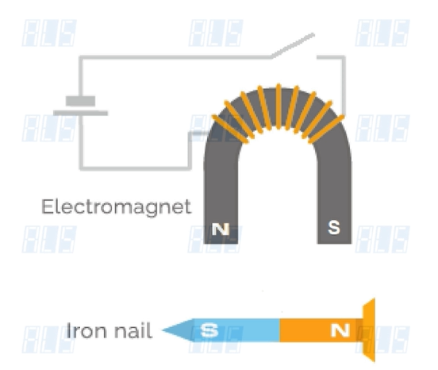

Slide 4
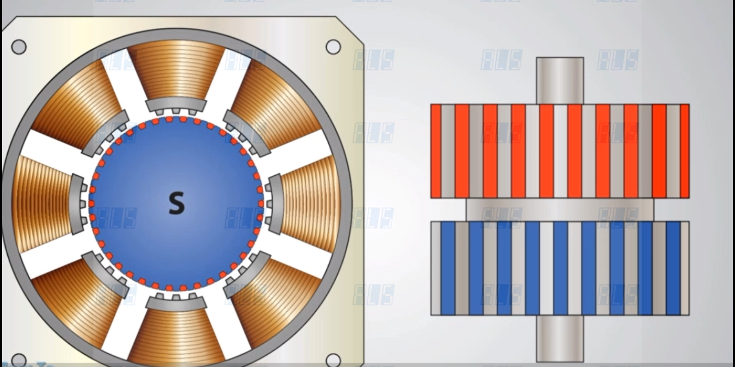

Slide 5
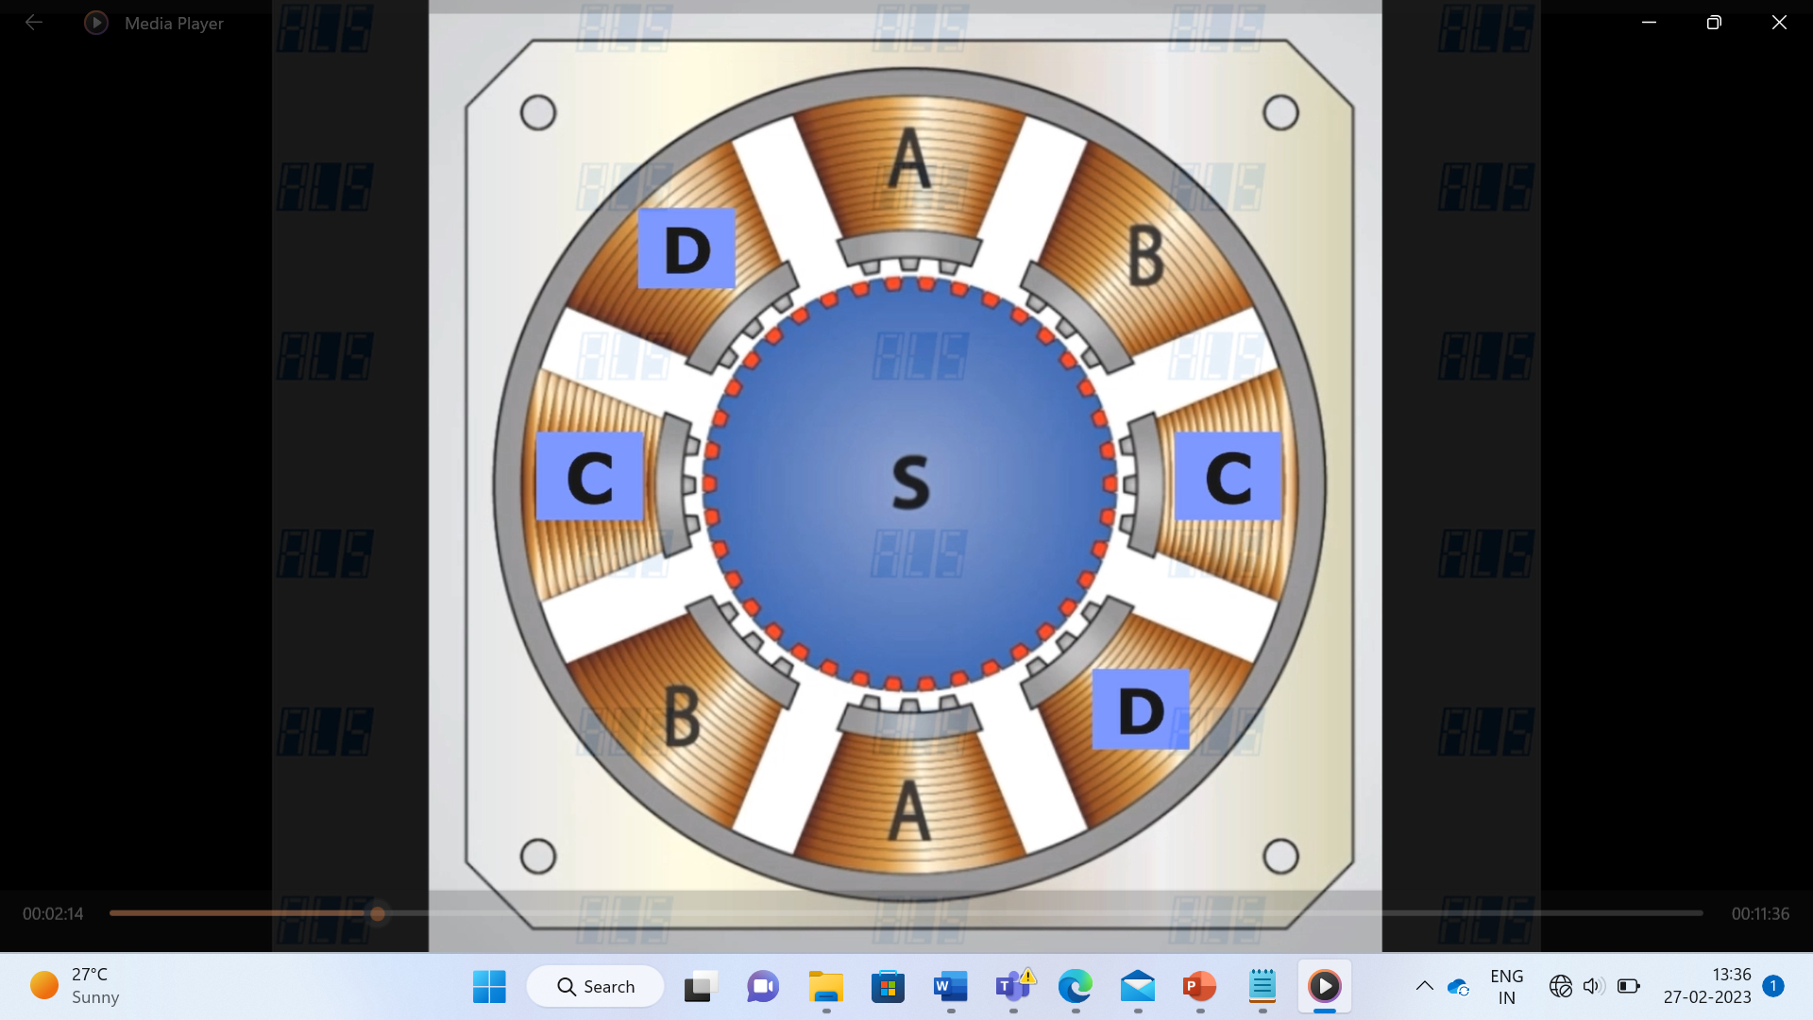
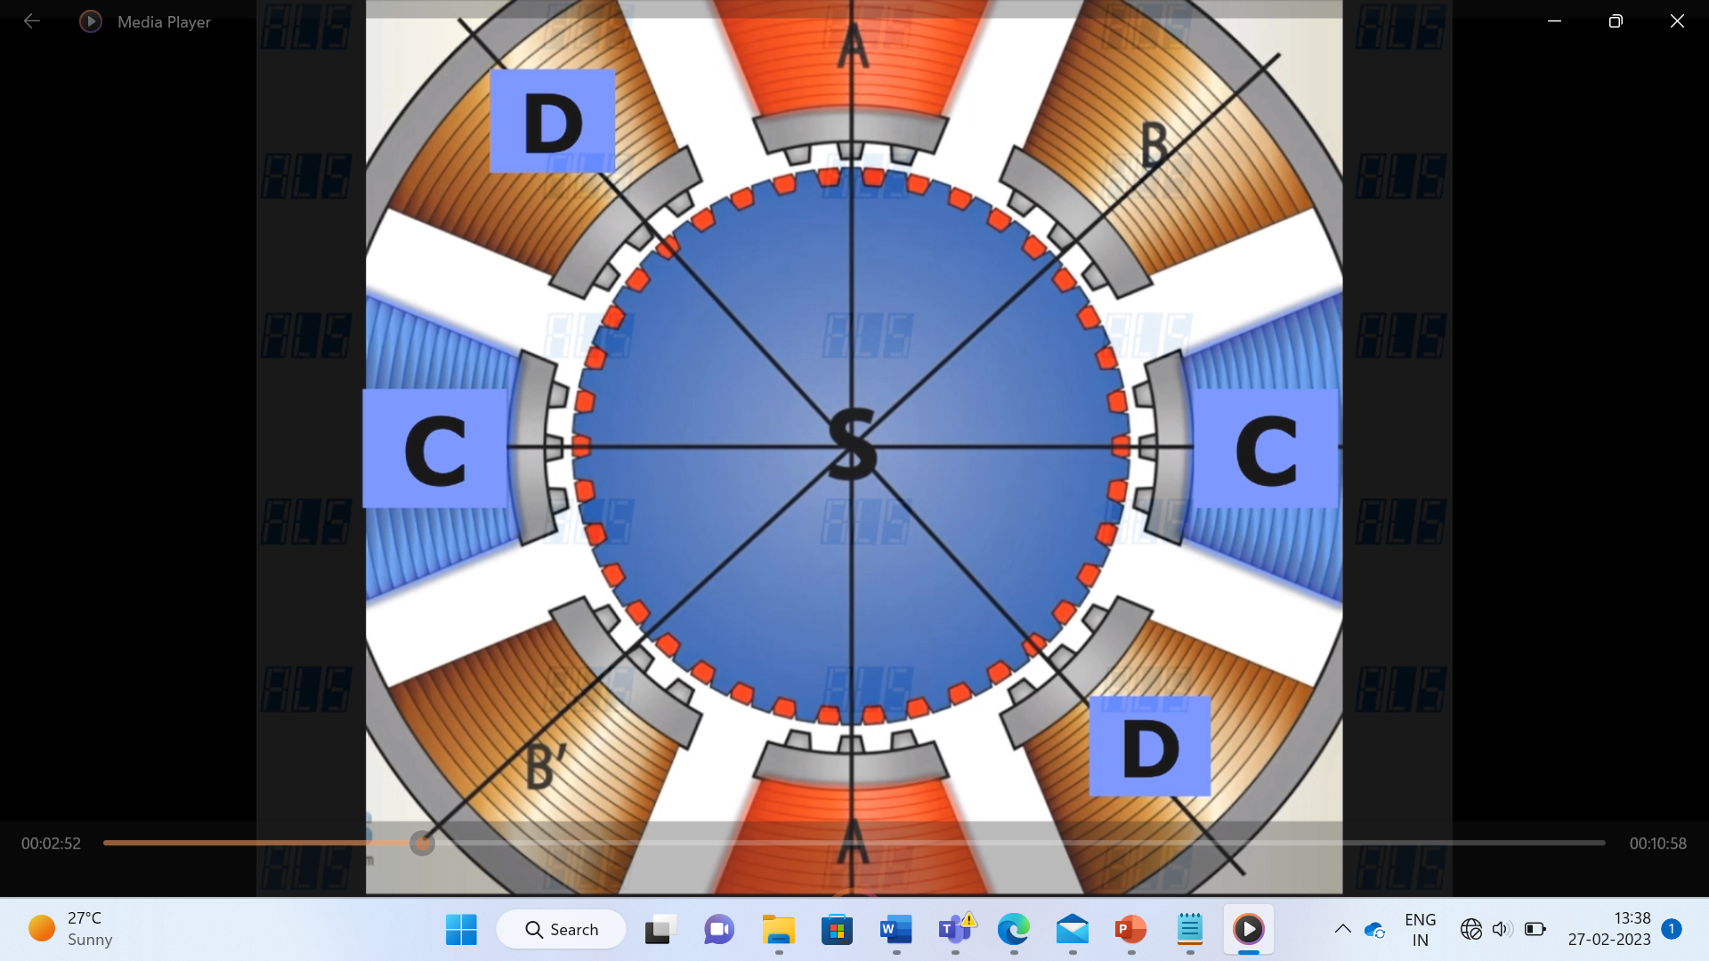

Slide 6
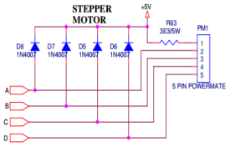
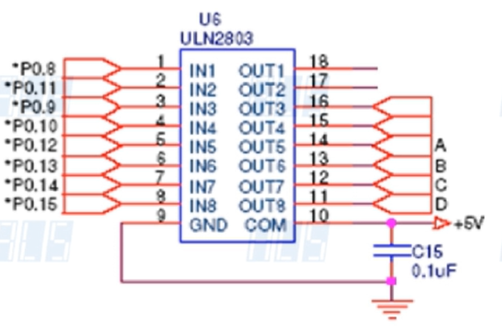

Slide 7
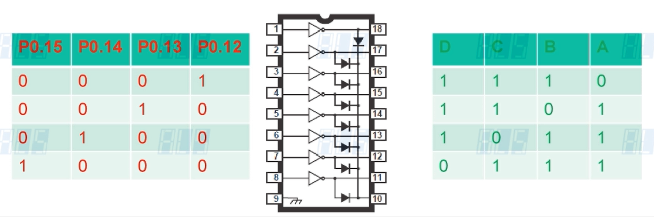

Slide 8
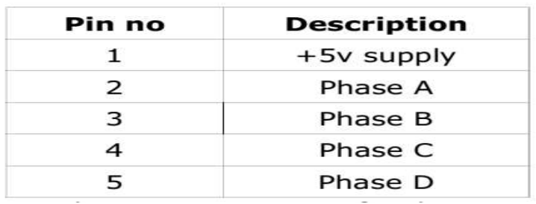

Slide 9
Steps to be followed Project
Creation in Keil uvision4 IDE:
Create a project folder before creating NEW project.
Use separate folder for each project
Open Keil uVision4 IDE software by double clicking on “Keil Uvision4” icon.
Select “Project” then to “New Project” and save it with a name in the respective Project folder, which is already you created.
Select the device as “NXP (founded by Philips)” Select “LPC1768” then Press “OK” and then press “YES” button to add “system_LPC17xx.s” file.
Go to “File” select “New” to open an editor window. Create a source file and use the header file “LPC17xx.h” in the source file and save the file. Color syntax highlighting will be enabled once the file is saved with a Recognized extension such as “.C “.
Right click on “Source Group 1” and select the option “Add Files to Group 'Source Group 1' “add the. C source file(s) to the group.
Again right click on Source Group 1 and select the option “Add Files to Group 'Source Group 1' “add the file - C:Keil\ARM\startup\NXP\LPC17xx\system_LPC17xx.c

Slide 10
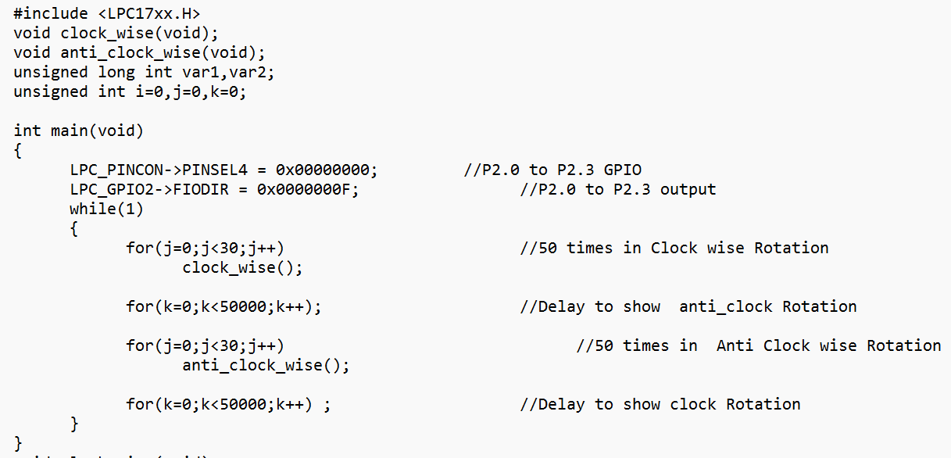

Slide 11
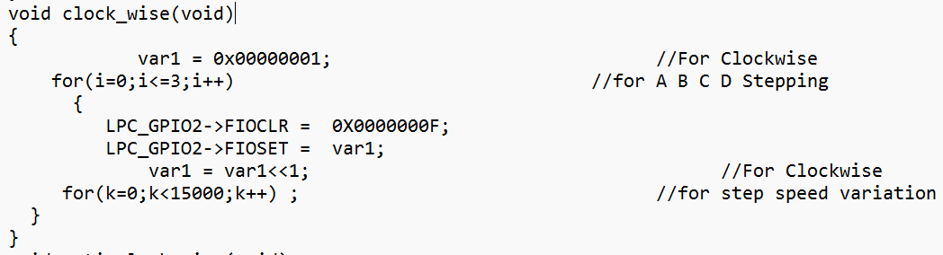
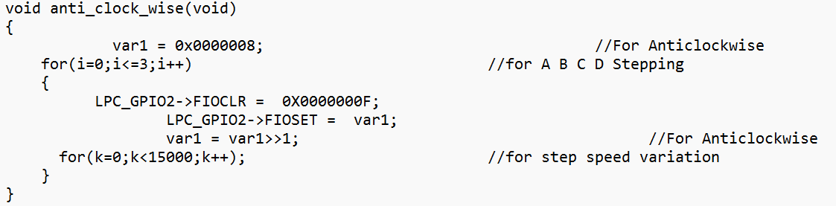

Slide 12
Any changes made to this file at current project will directly change the source system_LPC17xx.C file. As a result other project settings may get altered. So it is recommended to copy the file C:Keil\ARM\startup\NXP\LPC17xx\system_LPC17xx.c to the project folder and add to the source group.
Important: This file should be added during each project creation.
Select “Project” then select “Translate” to compile the File (s)
Select “Project” , select “Build Target” for building all source files such as “.C”,”.ASM”, “.h”, files, etc…This will create the hex file if there are no warnings & no errors

Slide 13
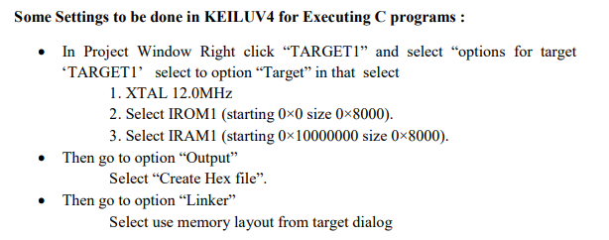

Slide 14
